Slide 1
Digital Portfolio
STUDENTS:YUVARAJAN.E
REGISTER NO:20324U108
NMID: E1D91C5FEF580988B7B4B58416EE24DC
BDEPARTMENT: BCA
COLLEGE: DR.MGR.CHOCKALINGAM ARTS COLLEGE
UNIVERSITY: THIRUVALLUVAR UNIVERSITY

Slide 2


AGENDA
Problem Statement
Project Overview
End Users
Tools and Technologies
Portfolio design and Layout
Features and Functionality
Results and Screenshots
Conclusion
Github Link
3/21/2024 Annual Review

Slide 3
PROJECT TITLE
STUDENT DIGITAL PORTFOLIO USING FRONT END DEVELOPMENT

Slide 4

PROBLEM STATEMENT
Problem Statement – Digital Portfolio
In today’s digital age, students and professionals face increasing challenges in presenting their skills, achievements, and creative work effectively. Traditional resumes, paper-based portfolios, and certificates often fail to capture the depth of an individual’s capabilities, as they lack interactivity, accessibility, and personalization.
Furthermore, employers, educators, and clients require a centralized, easily accessible, and well-organized platform to review candidates’ work. Without such a platform, individuals struggle to showcase their talents in a way that stands out in competitive environment

Slide 5

PROJECT OVERVIEW
Project Overview
The project showcased in this portfolio represents my skills, creativity, and ability to solve problems effectively. Each project is designed with a clear objective, detailed planning, and step- by-step execution to achieve meaningful outcomes.
Project Title: [Name of the project]
Objective: A brief description of what the project aims to achieve.
Tools & Technologies Used: List of software, platforms, or
programming languages applied.
Process / Approach: Key steps or methods followed in developing the project (e.g., research, design, coding, testing,
presentation).
Outcome: The final result achieved, supported by measurable impact or feedback.
Reflection: What I learned and how this project improve skills

Slide 6





WHO ARE THE END USERS?
1. Educators / Instructors
Review your portfolio for grading, assessment, or academic evaluation.
2. Employers / Recruiters
Use the portfolio to assess your skills, creativity, and professional readiness.
3. Clients / Customers (for freelancers or creative
professionals)
Review your past work to decide if they want to hire you or collaborate.
4. Peers / Colleagues
May use your portfolio for team projects, networking, or collaboration.
5. Yourself (the creator)
As a self-reflection tool to track your progress, growth, and achievements.

Slide 7

TOOLS AND TECHNIQUES
Tools (Platforms & Technologies)
1.Website Builders / Portfolio Platforms
WordPress, Wix, Squarespace, Weebly
Design & Editing Tools
Canva, Figma, Adobe Photoshop, Illustration
Productivity & Documentation Tools
Google Docs / Slides, Microsoft Word / PowerPoint
Techniques (Methods & Best Practices)
1.Content Organization
Structuring projects with clear sections: Overview → Process → Outcome → Reflection.
User Experience (UX)
Easy navigation with menus, links, and search features.
Showcasing Results
Including measurable outcomes (grades, feedback, metrics, awards).

Slide 8
POTFOLIO DESIGN AND LAYOUT
Portfolio Design and layout
Homepage / Landing Page
Clean introduction with name, tagline, and photo.
Navigation / Menu
Simple and consistent across all pages.
Project Showcase Layout
Grid or card-style design (thumbnail images or previews).
Visual Hierarchy
Use clear headings, subheadings, and secrets
Color Scheme & Typography
Pick 2–3 main colors (professional or matching your personal brand).

Slide 9

FEATURES AND FUNCTIONALITY
Features of a Digital Portfolio
1.Personal Information Section
Name, photo, contact details, short bio, resume/CV.
Showcase of Work / Projects
Organized display of projects (designs, code, artwork, writing, etc.).
Skills & Expertise
List of technical, creative, or professional skills.
Achievements & Certifications
Awards, certificates, recognitions.
Interactive Media
Videos, animations, or demo links recommendation
Functionality of a Digital Portfolio
Accessibility: Easy to access from anywhere, anytime (web or cloud).
Interactivity: Users can click, view, and explore projects dynamically.
Updates & Maintenance: Can be regularly updated with new
work.
Performance Tracking: Visitor analytics (views, clicks, downloads).

Slide 10

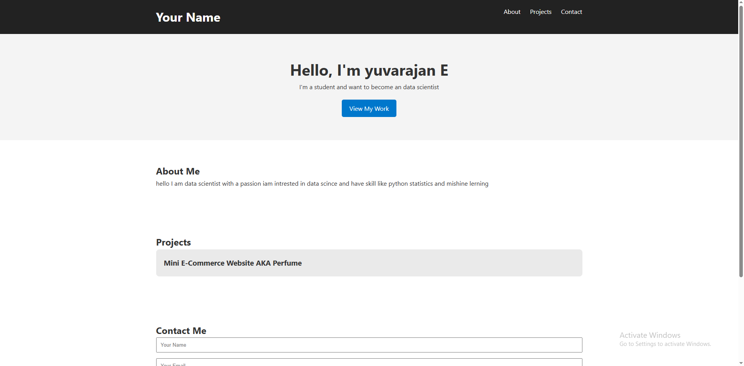


RESULTS AND SCREENSHOTS
Results Section
Description of Outcome
Briefly explain what was achieved.
Example: “Developed a responsive website that increased traffic by 35%.”
Metrics / Achievements
Use measurable data where possible:
Grades or scores (if academic).
3. Impact / Value
What problem was solved or improved?
Screenshot Section
Visual Proof: Add clear screenshots of your projects, designs, or websites.
Before & After (if applicable): Show improvements or
redesign results.
Highlight Key Features: Use annotations, captions, or callouts to explain the screenshot.
Multiple Formats:
For a website → homepage, dashboard, mobile view
.
3/21/2024 Annual Review
10

Slide 11
GITUP LINK: https://github.com/Yuvarajan01/Digital-Portfolio.git

Slide 12
CONCLUSION
The digital portfolio serves as a comprehensive showcase of my skills, knowledge, and accomplishments. It highlights not only the projects I have completed but also the tools,
techniques, and creative approaches I applied throughout my work.
By organizing my work into structured sections—such as
problem statements, project overviews, tools and techniques, results, and screenshots—this port demonstrates both my
technical expertise and problem-solving abilities.
Ultimately, this portfolio reflects my growth, learning journey, and professional development. It stands as evidence of my
ability to create impactful solutions, adapt to challenges, and
continuously improve. I aim for this portfolio to provide potential employers, educators, or collaborators with a clear understanding of my capabilities and to open pathways for future opportunies
11

